Slide 1
GDP vs Homeownership in the U.S.

Slide 2
Scope
Hypothesis: If a state has a higher GDP then it will have a higher homeownership rate
Dataset was retrieved from the St. Louis Federal Reserve Economic Data
Compiled data for each state from 1997 to 2018 with additional supporting categories:
GDP
Homeownership Rate
Median income
Unemployment rate
Average house price
Population
https://fred.stlouisfed.org/

Slide 3
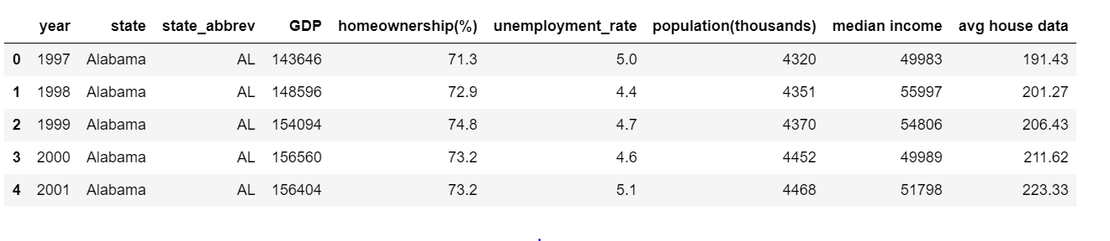
Dataset Preview

Slide 4
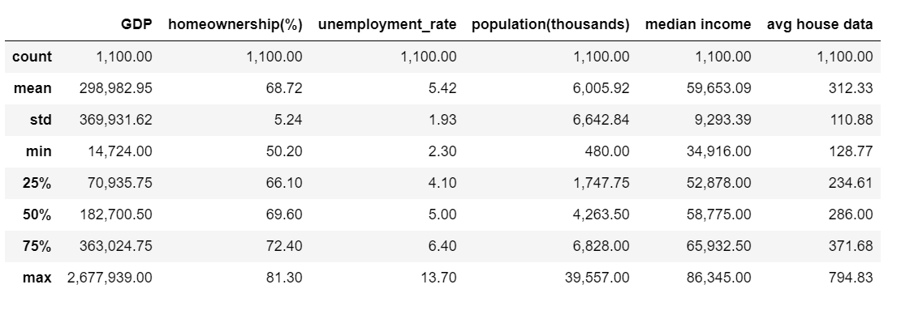
Descriptive Statistics

Slide 5
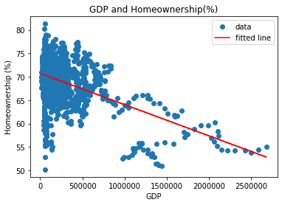
Exploratory Analysis
Regression testing the relationship between GDP and Homeownership across all states and all years:
Slope = -0.000007
Intercept = 70.715222
R-squared = 0.221190
P-value = 0.00000
Null hypothesis - no relationship between the variables

Slide 6
Initial Observations
Data is very clustered near the y axis or low end of GDP, but does show a possible negative linear relationship /downwards trend as GDP increases
This could possibly be explained by an increase in housing values as GDP increases therefore creating less affordability within the state’s population
Also high GDP states tend to have higher populations in urban areas where homeownership may be less common
This r-squared value indicates that the model explains about 22% of the variability of homeownership rate around its mean, so the linear model doesn’t fit the data especially well
The initial regression is not displaying a strong relationship between the two variables
There are too many moving factors that impact each variable year over year over the length of the dataset that would impact the relationship
Further analysis is needed to confirm the relationship between GDP and homeownership or other variables that could explain homeownership rates in the US

Slide 7
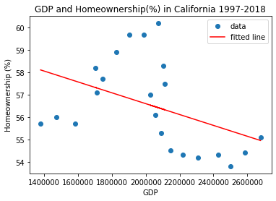
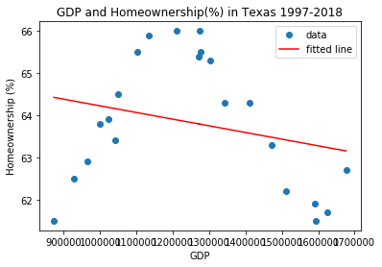
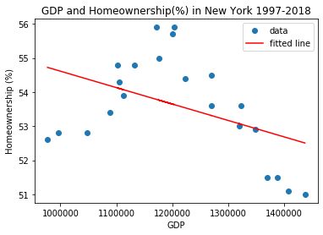
Individual Regressions on Top Three GDP States
California:
slope: -0.000002
intercept: 61.466515
R-squared: 0.177290
p-value: 0.051000
Texas:
slope: -0.000002
intercept: 65.802931
R-squared: 0.062314
p-value: 0.262560
New York:
slope: -0.000005
intercept: 59.431315
R-squared: 0.188488
p-value: 0.043500

Slide 8
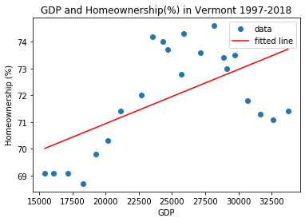
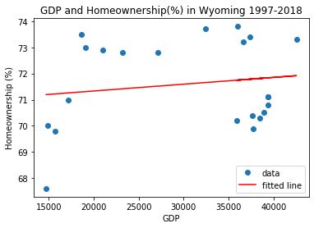
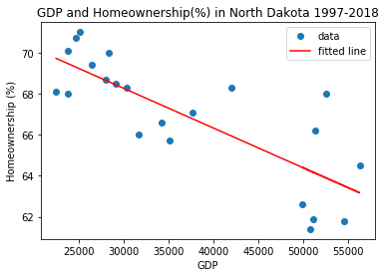
Individual Regressions on Bottom Three GDP States
Vermont:
slope: 0.000202
intercept: 66.895472
R-squared: 0.334761
p-value: 0.004788
Wyoming:
slope: 0.000026
intercept: 70.811250
R-squared: 0.023162
p-value: 0.498957
North Dakota:
slope: -0.000193
intercept: 74.056012
R-squared: 0.624131
p-value: 0.000012

Slide 9
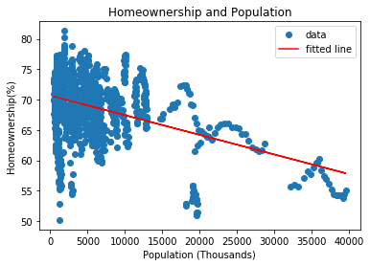
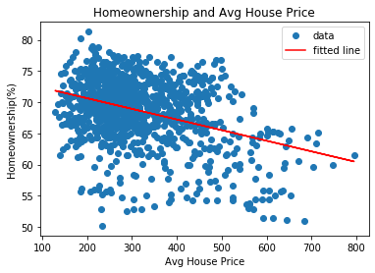
Homeownership vs Population & Average House Price
slope: -0.000323
intercept: 70.661077
R-squared: 0.167275
p-value:0.000000
slope: -0.017029
Intercept: 74.041632
R-squared: 0.167275
p-value: 0.000000

Slide 10
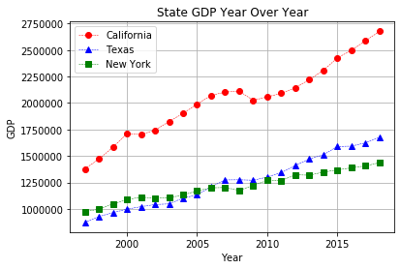
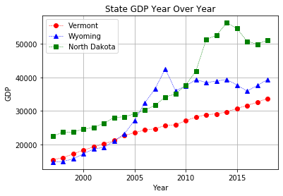
Top Three vs Bottom Three States: GDP

Slide 11
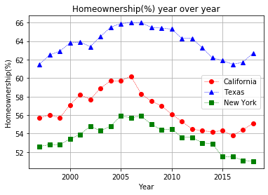
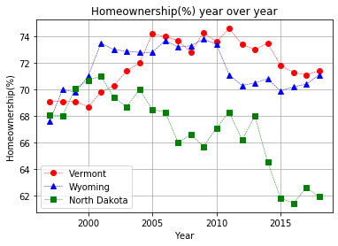
Top Three vs Bottom Three States: Homeownership

Slide 12
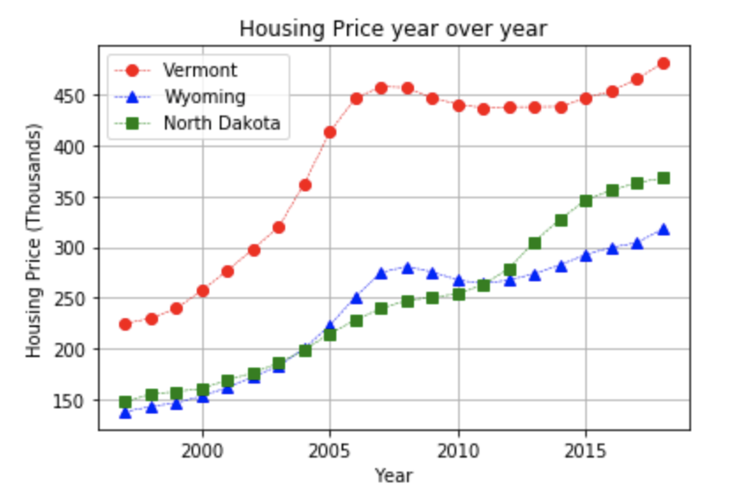
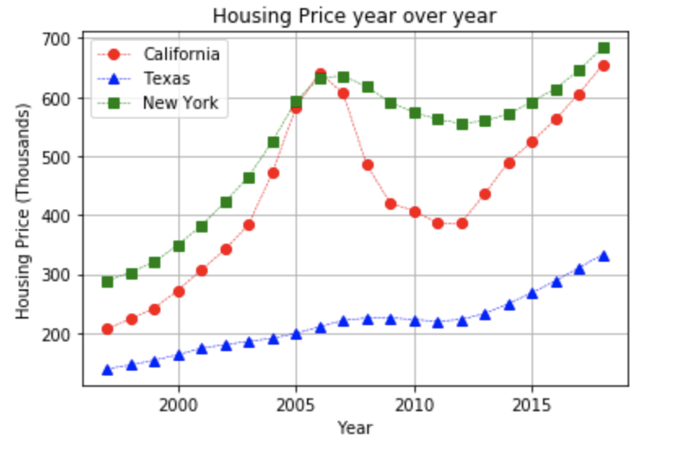
Top Three vs Bottom Three States: Average House Price

Slide 13
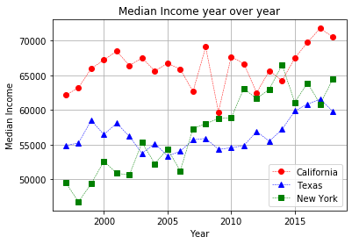
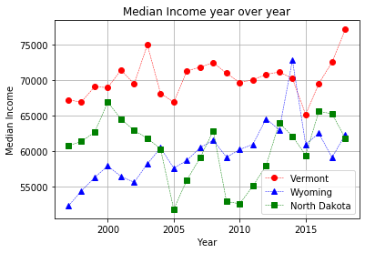
Top Three vs Bottom Three: Median Income

Slide 14
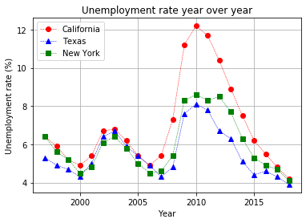
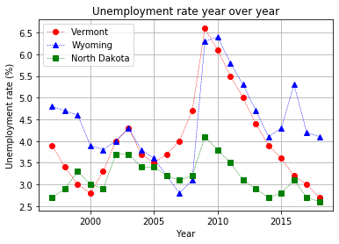
Top Three vs Bottom Three: Unemployment

Slide 15
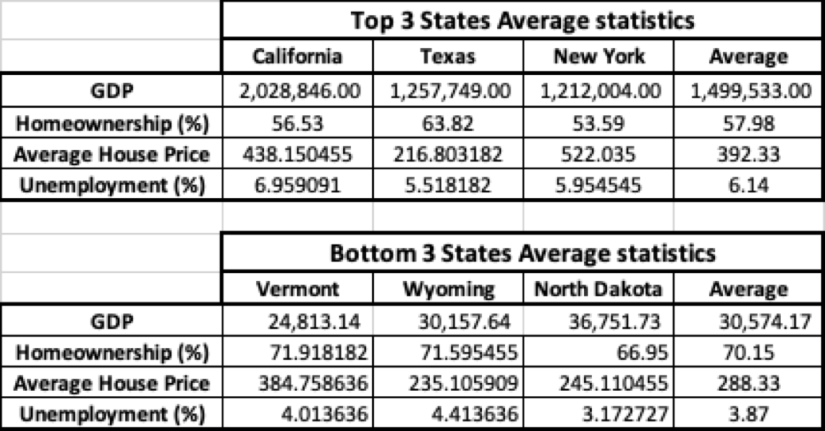
Resumed variables

Slide 16
Conclusion
Our initial hypothesis is incorrect;
There wasn’t any correlation between the Homeownership rates and GDP;
By analysing the extremes we could actually prove the contrary, which means that States with higher GDP have a lower homeownership rate;
The states with lower GDP showed a positive difference of approximately 12.17 percentual points, when in comparison with the top 3 states;
Although it is not statistically reliable to expand this conclusion to the whole population, the reasons for this difference can include:
Houses in states with lower GDP cost approximately 27% less on average;
Unemployment rates in lower GDP States are 37% lower;
The only statistical analysis that could be expanded to the population is that the GDP has a strong, positive correlation with Population size;

Slide 17
Conclusion
If given more time our group would try to build up profiles by analyzing each variable individually and look for clusters that might include a representative portion of the population. We would also have compared the variables against homeownership rate to see their individual impact.
We should not discard the limitations on the dataset, in which we are putting into perspective a limited set of variables to explain a complex subject. Additional time would also be used to gather more information to try and prove our hypothesis.

